Slide 1
Text Processing For NLP Understanding Regex
In this presentation, we will explore the power of regular expressions in Natural Language Processing (NLP) and how they can be applied to extract and preprocess data.

Slide 2



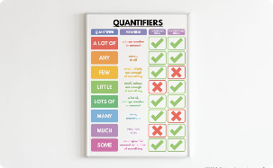
Getting Started with Regex
Learn the basics of Regular Expressions, including patterns, characters, metacharacters, escaping, and character classes.
Patterns and Characters
Metacharacters and Escaping
Character Classes and Ranges
Quantifiers and Repetition
Master the art of escaping special characters in regex and when to use metacharacters.
Unleash the power of character classes and ranges for matching different types of characters and numbers.
Understand how to use quantifiers and repetition to match patterns of characters with specific lengths.
Discover how to use regex to find specific patterns of characters in textual data.

Slide 3
Patterns and Characters
Introduction to Patterns: Regular expressions (regex) use patterns to match and manipulate text. These patterns consist of characters and metacharacters that define specific search criteria.
Literal Characters: Literal characters in a regex pattern match the exact characters themselves. For example, the pattern "apple" matches the word "apple" in the text.
Character Sets: Character sets allow matching any one of a set of characters. The pattern "[aeiou]" matches any vowel in the text.
Escaping Special Characters: Special characters like ".", "$", and "^" have special meanings in regex. To match them literally, they need to be escaped with a backslash, like ".", "$", "^".
Case Sensitivity: By default, regex is case-sensitive. To perform case-insensitive matching, flags can be used in the regex pattern.

Slide 4
Metacharacters and Escaping
Metacharacters: Metacharacters in regex have special meanings and functions. For instance, "." matches any character, while "^" and "$" respectively denote the start and end of a line.
Escaping Metacharacters: To match metacharacters as literal characters, they must be escaped with a backslash. For example, to match the dot character ".", use "." in the pattern.
Literal Matching: By escaping metacharacters, you can precisely match characters that would otherwise have special meanings.
Backslash Escaping: Since the backslash itself is an escape character in most programming languages, it must be escaped as well when using regex. Use "\" to match a literal backslash.
Metacharacter Combinations: Combining metacharacters with literal characters forms powerful patterns for complex text manipulation.

Slide 5
Character Classes and Ranges
Character Classes: Character classes, enclosed in square brackets "[ ]", allow matching any one character from a set. For example, "[aeiou]" matches any lowercase vowel.
Negation: Using the caret symbol "^" within a character class negates the match. "[^0-9]" matches any non-digit character.
Character Ranges: Ranges within character classes specify a range of characters to match. "[a-z]" matches any lowercase letter.
Combining Character Classes: Character classes can be combined to create more complex patterns. "[A-Za-z]" matches any letter, regardless of case.
Shorthand Character Classes: Shortcuts like "\d" for digits, "\w" for word characters, and "\s" for whitespace simplify pattern creation.

Slide 6
Quantifiers and Repetition
Quantifiers: Quantifiers determine the number of times a preceding character or group should appear in the text. For instance, "a{3}" matches "aaa".
Asterisk (*): The asterisk quantifier matches zero or more occurrences of the preceding character or group. "ba*" matches "b", "ba", "baa", and so on.
Plus (+): The plus quantifier matches one or more occurrences of the preceding character or group. "ca+" matches "ca", "caa", "caaa", and so on.
Question Mark (?): The question mark quantifier matches zero or one occurrence of the preceding character or group. "da?" matches "d" and "da".
Braces ({ }): Braces with a specific quantity, like "e{2}", match exactly that number of occurrences. "bee" matches "bee", but not "be".

Slide 7
Advanced Regex Techniques
Explore advanced Regular Expression techniques, including anchors, boundaries, groups, alternation, backreference, subpatterns, lookahead, and lookbehind.
Anchors and Boundaries
Groups and Capturing
Learn how to use anchors and boundaries to match specific positions within a string of text.
Discover how to use groups and capturing to extract useful and specific information.
Alternation and Logical OR
Backreference and Subpatterns
Understand how to use alternation and logical OR to match multiple patterns within a string.
Master the art of backreference and subpatterns to match complex patterns with nested structures.

Slide 8
Groups and Capturing
Grouping with Parentheses: Parentheses create groups to apply quantifiers and alternation to specific sections.
Capturing Groups: Parentheses also capture the matched content, which can be accessed for extraction.
Named Capturing Groups: Named groups provide a more descriptive reference to captured content.
Reusing Captured Content: Captured content can be used later in the regex pattern with backreferences.

Slide 9
Alternation and Logical OR
Alternation with |: The pipe symbol "|" allows multiple alternatives to be matched in the pattern.
Matching Multiple Alternatives: For instance, "apple|banana" matches either "apple" or "banana".
Non-Capturing Groups (?: ): Parentheses with "?" after the opening parenthesis create non-capturing groups.
Balancing Options: Alternation provides flexibility in matching different possibilities within a pattern.

Slide 10
Backreference and Subpatterns
Using Backreferences: "\n" (where n is a number) matches content previously captured by a group.
Repeating Captured Content: Backreferences allow patterns like "(apple)pie\1" to match "applepieapple".
Nested Subpatterns: Parentheses can be nested to create subpatterns, enabling more complex matches.
Subpattern Scope: Subpatterns are useful for applying quantifiers and alternation to specific portions of the pattern.

Slide 11
Best Practices for Using Regex in Python
Learn how to use the re module in Python 3 to apply regex on text data and how to parse and extract information from real-world use cases.
Data Extraction with Regex
Explore real-world use cases of regex in Python, including extracting URLs, emails, and phone numbers from unstructured text.
1
2
3
Introduction to re Module
Cleaning and Preprocessing with Regex
Get an overview of the re module in Python 3 and how to use it to apply regex on text data.
Discover how to apply regex to preprocess and clean text prior to further processing in Python.

Slide 12
Introduction to re Module
Importing the Module: Begin by importing the re module in Python using import re.
Using re.search(): Use re.search() to find the first match of a pattern in a string.
Using re.findall(): Employ re.findall() to extract all occurrences of a pattern in a string.
Flags for Flexibility: Utilize flags like re.IGNORECASE for case-insensitive matching.

Slide 13
Data Extraction with Regex
Extracting URLs: Use regex to identify and extract URLs from text, aiding web scraping and analysis.
Capturing Emails: Employ regex to capture and extract email addresses from text documents.
Phone Number Extraction: Regex assists in parsing and retrieving phone numbers from various formats.
Pattern Customization: Adapt patterns to different data formats for accurate extraction.

Slide 14
Cleaning and Preprocessing with Regex
Removing Unwanted Characters: Use regex to eliminate special characters, punctuation, or symbols.
Whitespace Management: Replace multiple spaces with a single space using regex for consistent formatting.
Text Normalization: Apply regex for converting text to lowercase, standardizing text representations.
Handling Redundancy: Identify repeated characters or words with regex and replace with a single instance.

Slide 15

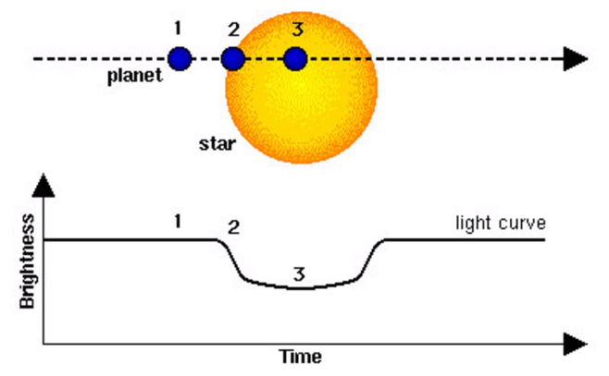
Limitations and Best Practices of Regex
Understand the limitations of Regex and how to apply best practices to maximize its performance.
Regex Limitations
Regex Best Practices
Explore the limits of regex when applied to Natural Language Processing and how to work around them.
Discover the best practices for using regex to maximize performance and maintainability of your code.

Slide 16
Conclusion
Regular Expressions are essential for text processing and Natural Language Processing. With the knowledge, skills, and best practices covered in this presentation, you will be able to apply regex effectively and efficiently to your data processing needs.
Regex Basics
Advanced Regex Techniques
Regex In Python
Patterns, Characters, Metacharacters, Escaping, Character Classes, Ranges, Quantifiers, Repetition.
re module, Data Extraction, Cleaning and Preprocessing, Limitations, Best Practices.
Anchors, Boundaries, Groups, Capturing, Alternation, Logical OR, Backreference, Subpatterns, Lookahead, Lookbehind.

